Slide 1



Introduction to EDA
(Exploratory Data Analysis)

Slide 2
RECORD LESSON

Slide 3
Agenda
The importance of Exploratory Data Analysis
Data Cleaning
Data Processing and the Concept of ETL
Data Visualization
Welcome

Slide 4
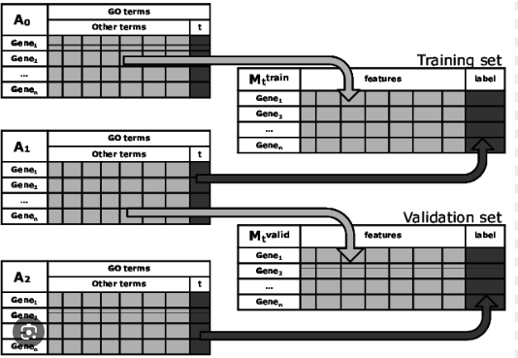
What is EDA?
Exploratory Data Analysis (EDA) is a crucial step in the data analysis process, which involves examining the main characteristics of a dataset, often visually, before making any assumptions or building statistical models. This approach helps in uncovering patterns, spotting anomalies, testing hypotheses, and checking assumptions through summary statistics and graphical representations.
How many rows?
What is the avg of “Total”? Does it make sense?
Is there any data missing in variable “C”?
Welcome

Slide 5
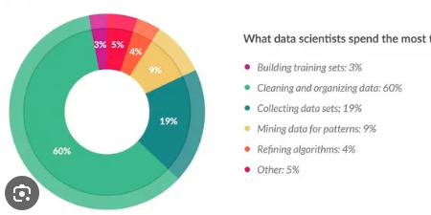
Data Cleaning
Assume the data is dirty - but what does this mean?
You will be faced with datasets of inconsistent data, that you will need to fix - aka, clean - yourselves.
San Francisco, CA, USA
San Franciso, California, USA (typo)
san francisco, california, usa (case issues)
SF, California, USA (abbreviation)
San Francisco CA USA (missing commas)
S. Francisco, California, USA (shortening)
San Francisco, Calif., USA (different abbreviation)
San Francisco - California, USA (alternative delimiter)
san francisco, ca, usa (case and abbreviation issues)
San Fran, CA, USA (nickname)
SAN FRANCISCO, CALIFORNIA, USA (all caps)
San Francisco California, USA (missing comma)
San Fransisco, California, USA (typo)
Saint Francisco, California, USA (formal/incorrect name)
SFO, California, USA (airport code used as city name)
San Francisco, Cali, USA (informal abbreviation)
San Fran., Cal., USA (abbreviated with periods)
San Francisco Calif USA (missing punctuation)
San Francisco, Cal., US (country abbreviation inconsistency)
San Francsco, California, US (typo and country abbreviation inconsistency)
Welcome

Slide 6
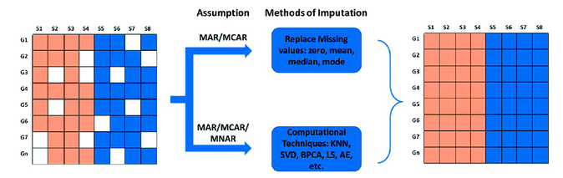
Data Injection
Cleaning data is no just about typos - often you will also having missing data that is central to your analysis.
“Something” is often better than nothing. But which “something?
Common imputation techniques:
Mean
Median
Mode
Zero
and many more
Welcome

Slide 7
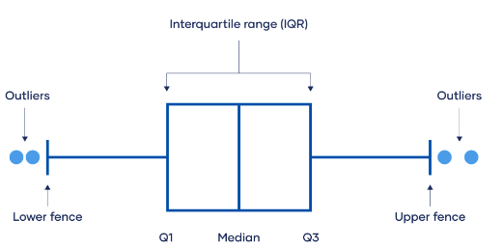
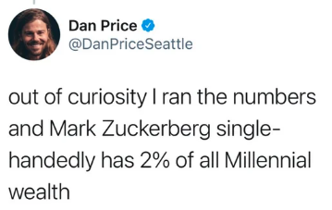
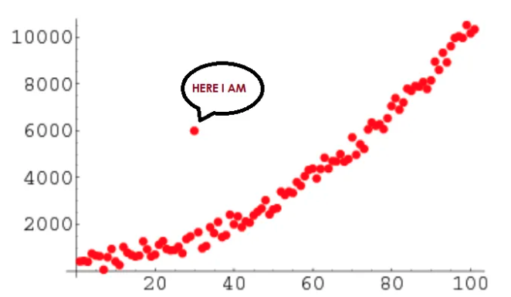
Outliers
The concept of an outlier is a point that is valid - it exists in our data and in reality - but it is not representative of our dataset.
Welcome

Slide 8
Outliers
What should we do about Outliers?
There is no Golden Rule – Outliers are still valid situations in our reality
Welcome

Slide 9
Outliers
What should we do about Outliers?
Sales of a shop
vs
Wealth of Millenials
Welcome

Slide 10
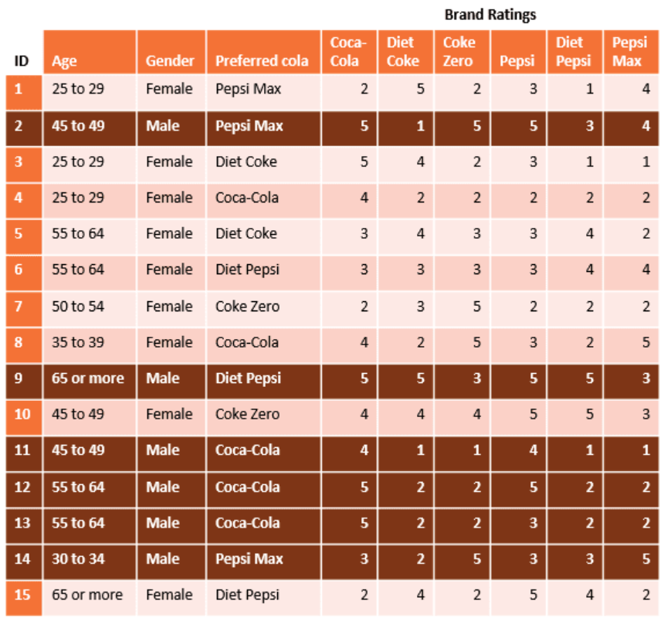
Data processing - Filtering
Filtering is one of the main parts of EDA - it reflects our choice over the analysis that we want to do and which data we want to include.
Filtering is done by rules, not by hand
- Filter on a subset of elements
- Filter on a condition (a > b) or a combination of condictions
- Filter on an issue (remove Nas or invalid rows)
Filtering is done on the rows
Welcome

Slide 11
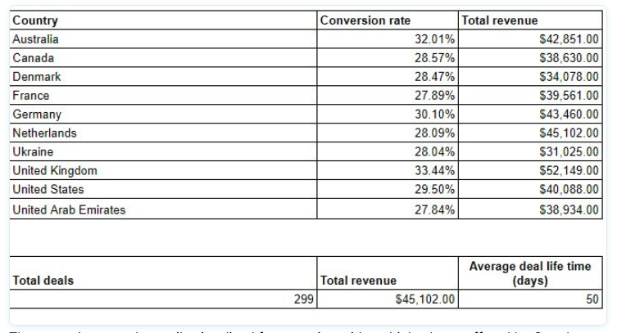
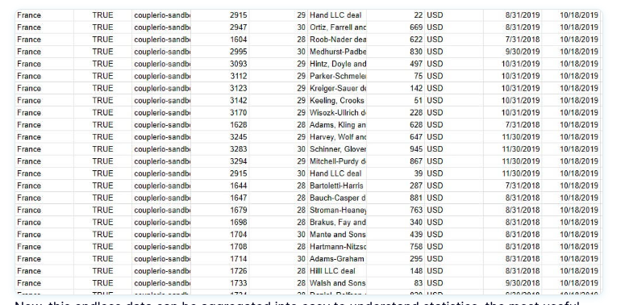
Data processing - Aggregations
The importance of aggregating data cannot be overstated. Every time technology advances, humanity is able to collect and process a high and more detailed volume of data – but the human brain still needs to understand high level, aggregated data to have a full picture.
Welcome

Slide 12
Data processing – Transformation
During our data flow, transformations will be necessary – and they start in our exploratory analysis.
Transformations / Formulas: often we will need to alter what the data looks like
Date of birth becomes Age
02/07/1988 35
Welcome

Slide 13
Data processing – Transformation
During our data flow, transformations will be necessary – and they start in our exploratory analysis.
Transformations / Formulas: often we will need to alter what the data looks like.
Statistical Analysis: normalization, standardization
Wealth Rage becomes Wealth Rage normalized
30$-13B$ 0-1
Welcome

Slide 14
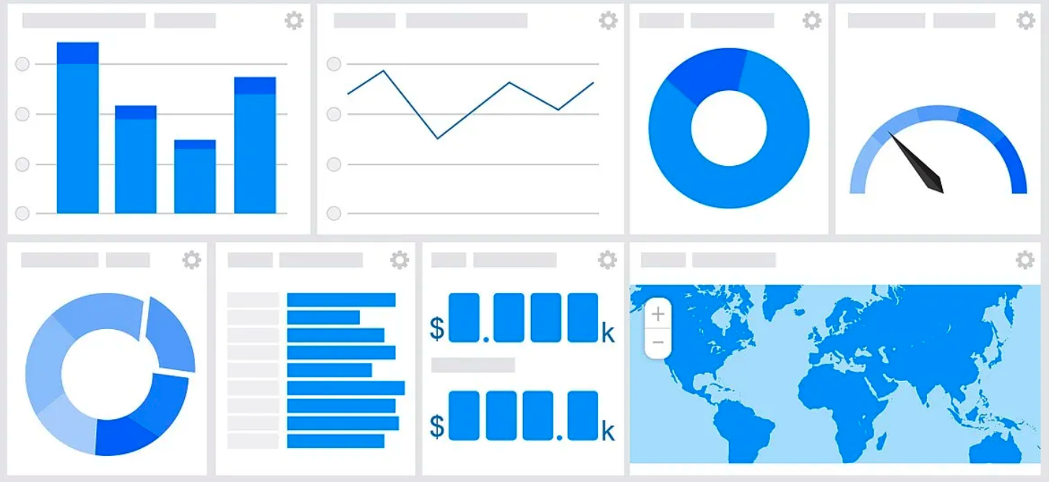

Data Visualization
The outcome of all Data Analysis it for a user make an informed decision – that information needs to be shared with the user in some sort of visual matter – often through charts.
The way we visualize that data is, in itself, a science: Data Visualization
Welcome

Slide 15
Data Visualization
As we study how to visualize data, there are several areas of DataViz to be studied.
What can be displayed:
DIMENSIONS:
Data Attributes
Examples: Geo-Location (City, Country), Categorical Breakdown
(Usually) strings METRICS:
METRICS
Measurable values that describe your data
Examples: Sales, Profit, dedicated KPIs (what are KPIs??)
Welcome

Slide 16
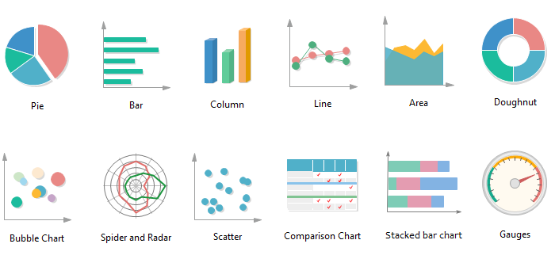
Data Visualization
As we study how to visualize data, there are several areas of DataViz to be studied.
The different ways it can be displayed
Welcome

Slide 17
Thank you
Let’s get started!

